Slide 1

Scientificity Behind Dynamisation
Dr. R. Valavan, BHMS, MD (Hom), MBA, PhD
DrValavans’ Homeopathy
11-Aug-2026

Slide 2
Hahnemann’s view of Dynamisation - § 269
…changes... brought... by means of friction...
This (dynamic power) is brought about by trituration and succussion, but under the condition of employing an indifferent vehicle in certain proportions.
…curative powers of the minute doses of medicines prepared according to homoeopathic rules (dynamized).

Slide 3

Hahnemann’s view of Dynamisation - § 269
…rubbing it (steel rod) with a dull file in one direction, will it become a true active powerful magnet, one able to attract iron and steel to itself and impart to another bar of steel by mere contact and even some distance away, magnetic power and this in a higher degree the more it has been rubbed.
In the same way will triturating a medicinal substance and shaking of its solution (dynamization, potentation) develop the medicinal powers hidden within and manifest them more and more or if one may say so, spiritualizes the material substance itself.

Slide 4
Attempts to find out the characteristics of high dilutions
1906: Radium bromide 60x causes fogging of a photographic plate (Boerick and Tafel, 1906).
1936: Boyd WE. Research on the Low Potencies of Homoeopathy, an Account of Some Physical Properties Indicating Activity. London, United Kingdom: Heinemann, 1936
1957: Brucato A, Stephenson J. The photometric determination of the concentration of homoeopathic dilutions of mercuric sulfide (HgS). J Am Inst Homeopath 1957;50:242–243, 253
1966: Brucato A, Stephenson J. Dielectric strength testing of homeopathic dilutions of HgCl2. J Am Inst Homeopath 1966;59:281–286
1968: Smith, R. B., and Boericke, G. W. (1968). Changes caused by succussion on NMR patterns and bioassay of Bradykinin triacetate (BKTA) succussions and dilutions. Journal of American Institute of Homeopathy, 61, 197-212.
1971: Datta DD, Bose PC, Ghosh D. Spectrophotometric estimation of elemental sulphur in homoeopathic sulphur mother tincture and 4 × dilution. J Am Inst Homeopath 1972;65:53–55

Slide 5
Attempts….
1972: Heintz E. [Measurement of the action of serial dilutions by means of electric elements]. Ann Hom Franc 1972;14:275–284
1975: Khan MT, Saify Z. Estimation of low and higher homoeopathic potencies by means of biochemical and pharmacological methods, second research report. J Am Inst Homeopath 1975;68:97–104
1976: Boiron J, Vinh CLD. Contribution to the study of the physical structure of homoeopathic dilutions by Raman laser effect. In: Intérêt d'adhérer à la LMHI, ed. 31e Congres de la Ligue Médicale Homéopathique Internationale Athens, Greece, 17.05.1976–22.05.1976 Athens, Greece: Eigenverlag, 1976:459–474
1977: Gautam RS, Tewari KP, Roper NK, Mishra RK. Spectrophotometric analysis of potentisation of Euphrasia officinalis. Hahnemann Gleanings 1977;44:1–5
1977: Khan MT, Mriphh MCS, Akber MN. Determination of plumbum in the low and high homoeopathic potencies by means of eel atomic absorption spectrophotometer. In: LMHI, ed. 32nd International Homeopathic Medical Congress of the International Homoeopathic Medical League, New Delhi, India, October5–11, 1977:126–129

Slide 6
Attempts…
1981: Hadley SJ. An experiment showing an increase with dilution in a physical parameter. Br Hom J 1981;70:129–135
1983: Sacks AD. Nuclear magnetic resonance spectroscopy of homeopathic remedies. J Holist Med 1983;5:172–177
2003: Rey L. Thermoluminescence of ultra-high dilutions of lithium chloride and sodium chloride. Physica A 2003; 323: 67-74.
2005: Sukul NC, Ghosh S, Sukul A, Sinhababu SP. Variation in fourier transform infrared spectra of some homeopathic potencies and their diluent media. J Altern Complement Med 2005;11:807–812

Slide 7
Recent developments in this aspect

Slide 8
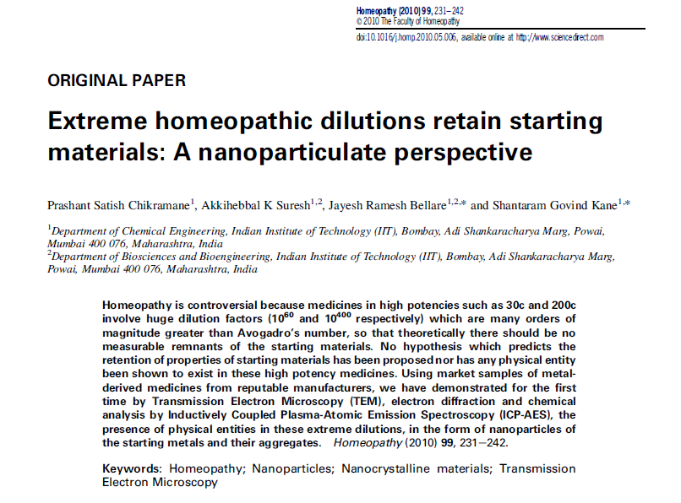
A breakthrough nanoparticle study

Slide 9
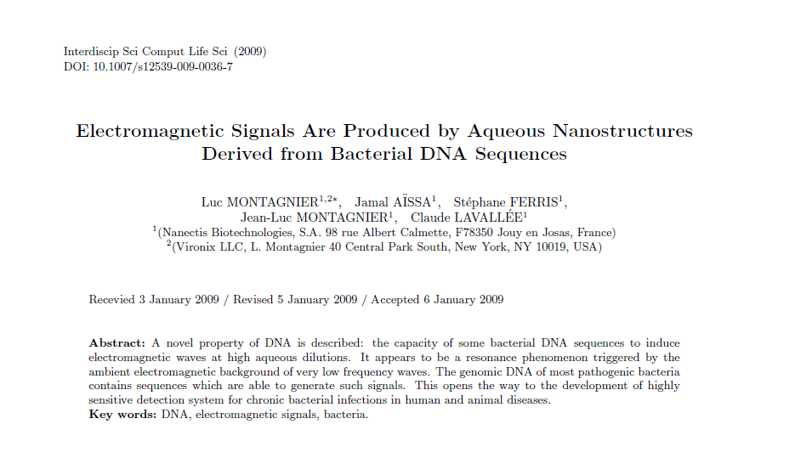
A breakthrough EM signals of aqueous HD DNA sequences study

Slide 10
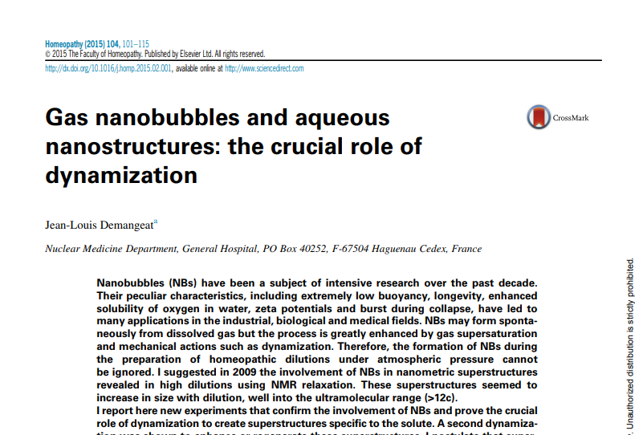

Slide 11
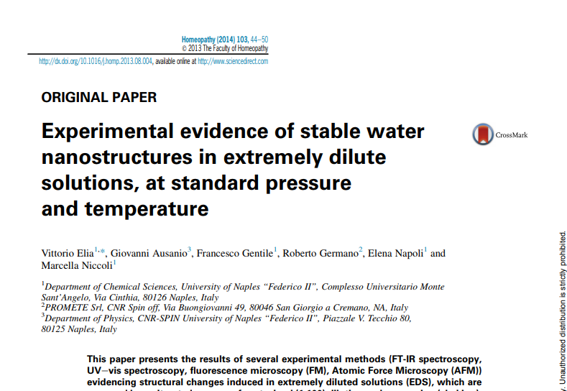

Slide 12

Conclusion
Homoeopathic medicines contain nanoparticle developed by creation of nanobubbles

Slide 13
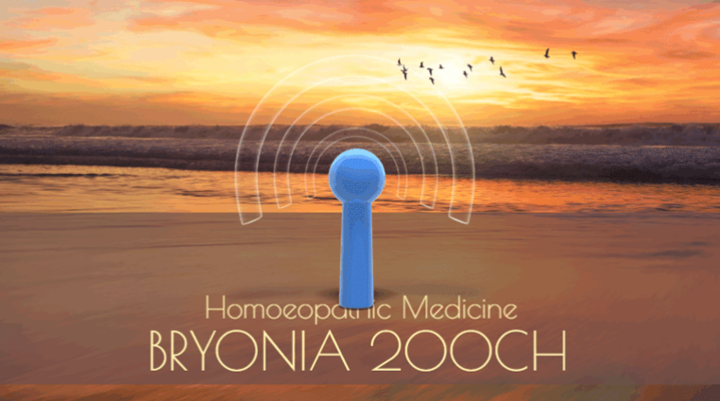
Conclusion
Homoeopathic medicines emanate electro magnetic signals even beyond Avogadro's limit.

Slide 14
A long way to go…
Though the discovery of nanoparticles and electromagnetic signals are important steps in the history of homoeopathic basic research, we still have go a long way to find out:
the mode of action of these nanostructures in the human body
differentiation of characteristics of nanopaticles and EM signals between one drug to another and one potency to another potency
and many more..

Slide 15
Conclusions
Homoeopathic medicines possess nano-particles developed as nanobubbles during the process of potentisation.
They also emanate electromagnetic signals.
Still we have to go a long way to find out the mode of action, differentiation in characteristics, etc.

Slide 16
Thank you

